Slide 1
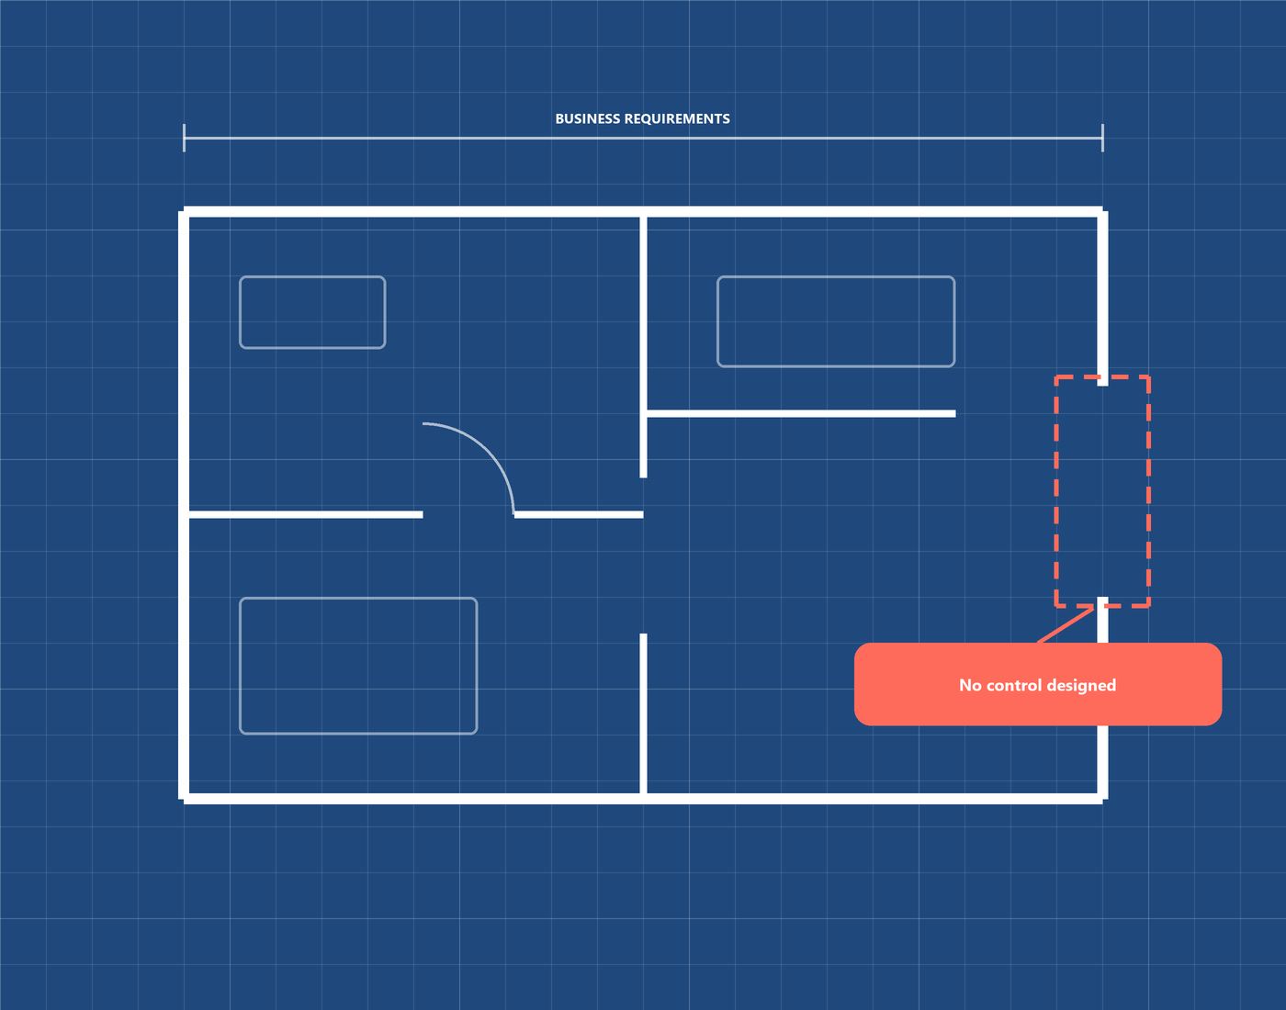

OWASP TOP 10 · 2025
A06:2025
Insecure Design
Missing or ineffective control design: when the flaw is in the blueprint, not in the code.
Notes:
Portada. Presentar el tema: A06:2025 Insecure Design, el riesgo número 6 del OWASP Top 10 de 2025. Es un riesgo de DISEÑO, no de código.

Slide 2
DEFINITION
What is this vulnerability?
Insecure Design is a broad category of weaknesses described as “missing or ineffective control design”. The system works as designed, but the design never included the protection needed.
Architecture flaws
Risks that come from design and architecture decisions, made before any code exists.
Business-logic flaws
No definition of unwanted or unexpected state changes inside the application.
Missing practices
Little threat modeling, no secure design patterns, no reference architectures.
Ranking: introduced in 2021 at #4; now #6, as A02 and A03 moved above it.
Notes:
¿Qué es? Es una categoría amplia: controles que faltan o son ineficaces EN EL DISEÑO. Bajó del puesto 4 al 6, pero porque A02 y A03 la superaron y porque la industria mejoró en threat modeling.

Slide 3
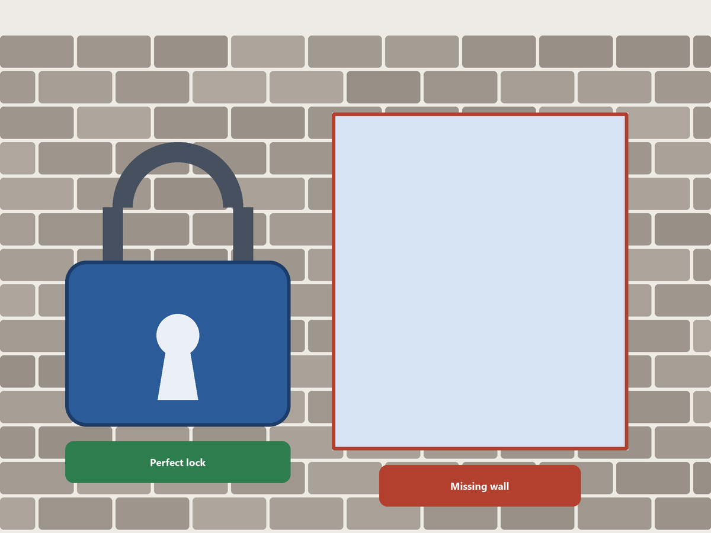
CORE CONCEPT
Design flaw vs. implementation bug
Design flaw
Implementation bug
The control was never created.
Root cause: missing requirements or threat model.
Found at: requirements and design.
Fix: redesign the flow.
The control exists but is coded wrongly.
Root cause: a coding defect.
Found at: development and testing.
Fix: patch the code.
Key idea: an insecure design cannot be fixed by a perfect implementation, because the needed control was never built.
Notes:
Idea central: diseño inseguro NO es lo mismo que implementación insegura. Tienen distinta causa raíz, ocurren en momentos distintos y se corrigen distinto. Un diseño seguro puede tener bugs, pero una implementación perfecta no arregla un control que nunca se diseñó.

Slide 4
SECURE BY DESIGN
The three parts of a secure design
1
Requirements & resources
2
Secure design
3
Secure development lifecycle
Define protection needs: confidentiality, integrity, availability, authenticity.
Agree on the expected business logic and how exposed the app is.
Budget design, build, test and operation, including security.
A culture and methodology that constantly evaluates threats.
Threat model in refinement sessions; look at data-flow and access changes.
Define normal and failure flows, and document them in the user story.
Secure design patterns, paved-road components, secure component library.
Involve security specialists from the start and through maintenance.
Learn from incident post-mortems; use OWASP SAMM.
Secure design is a culture and a methodology, not a tool you can bolt onto software.
Notes:
Para tener un diseño seguro hacen falta tres partes: requisitos y recursos, diseño seguro (threat modeling) y un ciclo de desarrollo seguro.

Slide 5
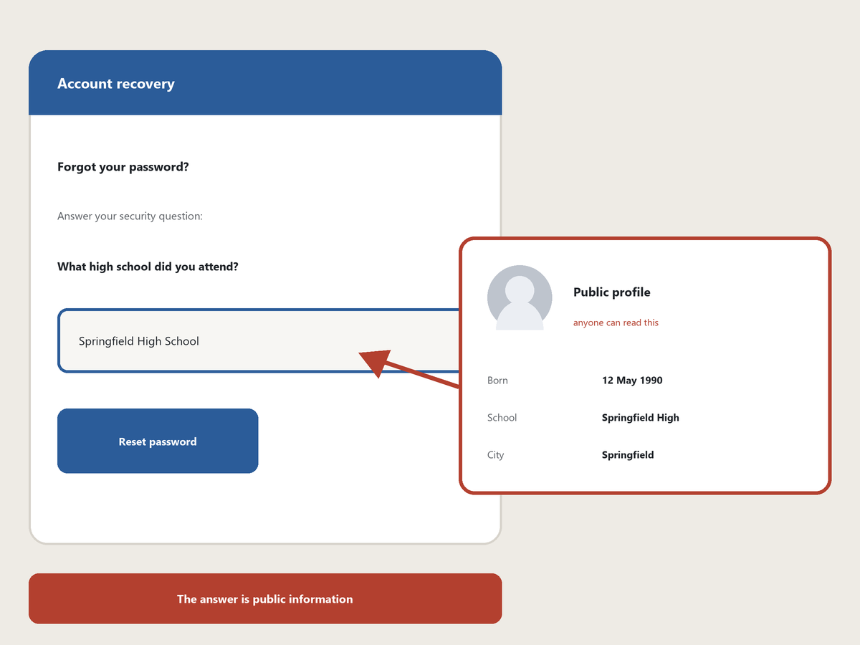
ACCOUNT RECOVERY BY SECURITY QUESTIONS
Real case: Yahoo! account takeover (2008)
No password was cracked
What happened. In September 2008, a student took over the personal Yahoo! Mail account of vice-presidential candidate Sarah Palin.
How. He looked up public details, such as her high school and birthdate, and used the account-recovery flow for forgotten passwords.
Why it is a design flaw. The recovery flow trusted answers that anyone can look up. No coding bug was needed.
OWASP Scenario #1. Questions and answers are prohibited by NIST 800-63b and OWASP ASVS: more than one person can know the answers. Remove the feature and replace it with a more secure design.
Source: Wikipedia, “Sarah Palin email hack”; OWASP Top 10:2025 A06, Scenario #1.
Notes:
Caso real: en 2008 un atacante tomó el correo Yahoo de Sarah Palin, entonces candidata a la vicepresidencia de EE. UU. Usó datos públicos (fecha de nacimiento, colegio) para pasar el flujo de recuperación de contraseña. Es exactamente el Escenario #1 de OWASP: las preguntas secretas no prueban identidad porque más de una persona conoce las respuestas. Fuente: Wikipedia, 'Sarah Palin email hack'.

Slide 6
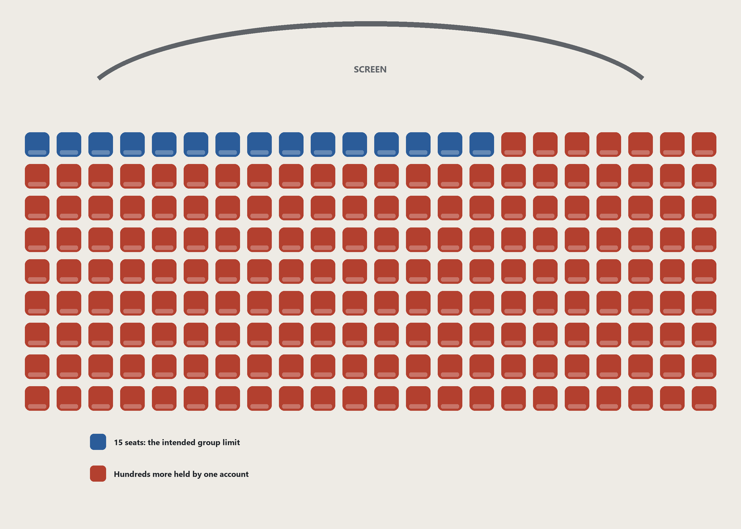
EXAMPLE · SCENARIO #2
Group bookings in a cinema chain
1 THE BUSINESS RULE
Group discount. Up to 15 attendees; more than that requires a deposit.
2 THE ABUSE
An attacker threat-models the flow and books 600 seats in all cinemas at once, in a few requests.
3 THE IMPACT
Seats are blocked and cannot be sold again: a massive loss of income.
POST /api/bookings
{"cinema": "ALL", "seat_ids": [1 … 600]}
Source: OWASP Top 10:2025, A06, Scenario #2. Request shown is illustrative.
Notes:
Ejemplo principal (Escenario #2 de OWASP): una cadena de cines da descuento a grupos y exige depósito si son más de 15 asistentes. Si el atacante hace threat modeling del flujo, puede reservar 600 asientos en todos los cines en pocas peticiones. Nada en el diseño limitaba el total.

Slide 7
VULNERABLE DESIGN
The booking endpoint without business rules
@app.route("/api/bookings", methods=["POST"])
@login_required
def book_seats():
seat_ids = request.get_json()["seat_ids"] # any number, any cinema
# FLAW: the design never defined limits. The rule 'max 15 seats,
# more needs a deposit' exists only in the marketing text.
for seat_id in seat_ids:
db.execute("UPDATE seats SET status='BOOKED', user_id=? WHERE id=?",
(current_user.id, seat_id))
return jsonify({"booked": len(seat_ids)}), 201
Why it fails: the code is correct for the request it receives, but no one decided what a legitimate booking looks like. Perfect code would not fix it.
Illustrative code written for this presentation; not taken from the OWASP page.
Notes:
Código ilustrativo escrito por nosotros (no es de la página de OWASP). El código 'funciona', pero la regla de negocio de los 15 asientos y el depósito nunca se aplica en el servidor. No hay bug de sintaxis: falta el control.

Slide 8
REMEDIATION PATTERN
The same endpoint, with the rule designed in
MAX_GROUP_SIZE = 15 # business rule, agreed with the business
MAX_ACTIVE_HOLDS = 15 # per account, across all cinemas
HOLD_MINUTES = 10 # held seats expire
@app.route('/api/bookings', methods=['POST'])
@login_required
@rate_limit('5/minute') # plausibility check at the API tier
def book_seats():
seat_ids = request.get_json()['seat_ids']
if len(seat_ids) > MAX_GROUP_SIZE:
return require_deposit(seat_ids) # rule enforced on the server
if active_holds(current_user.id) + len(seat_ids) > MAX_ACTIVE_HOLDS:
return jsonify({'error': 'Hold limit reached'}), 429
hold_seats(current_user.id, seat_ids, minutes=HOLD_MINUTES)
Key takeaway: write the rule, enforce it on every tier, and test it with misuse cases.
Illustrative code written for this presentation; not taken from the OWASP page.
Notes:
Corrección ilustrativa: la regla de negocio pasa a ser parte del diseño y se aplica en el servidor: tope por reserva, tope de reservas activas por usuario, depósito si excede, y retención con expiración. Además se debería probar con casos de abuso (misuse cases).

Slide 9
STRATEGIES OF MITIGATION
How to prevent it
Secure lifecycle & patterns
Threat modeling
Use a secure development lifecycle with AppSec professionals.
Build a library of secure design patterns and paved-road components.
Apply it to authentication, access control, business logic and key flows.
Use it also to teach a security mindset.
Requirements & tests
Architecture
Put security language and controls into user stories.
Write unit and integration tests with use cases and misuse cases per tier.
Plausibility checks at every tier, from frontend to backend.
Segregate tiers and tenants by design.
Resources: OWASP SAMM (Design) · OWASP Cheat Sheet: Secure Design Principles · The Threat Modeling Manifesto
Notes:
Cómo prevenir, según OWASP: ciclo de desarrollo seguro con profesionales de AppSec, librería de patrones de diseño seguro, threat modeling en autenticación, control de acceso y lógica de negocio, requisitos de seguridad en historias de usuario, pruebas con casos de uso y de abuso, y segregación de capas y de inquilinos.

Slide 10
TAKEAWAYS
Conclusion
Design comes first
Q&A
Security starts at requirements and design, before the first line of code.
Code cannot fix a missing control
Insecure design and insecure implementation have different causes and different fixes.
Questions?
Threat model, then test
Model abuse of key flows, write the rules down, and test them with misuse cases.
Notes:
Conclusión: el diseño inseguro se corrige antes de escribir código. Cerrar con preguntas.

